Slide 1
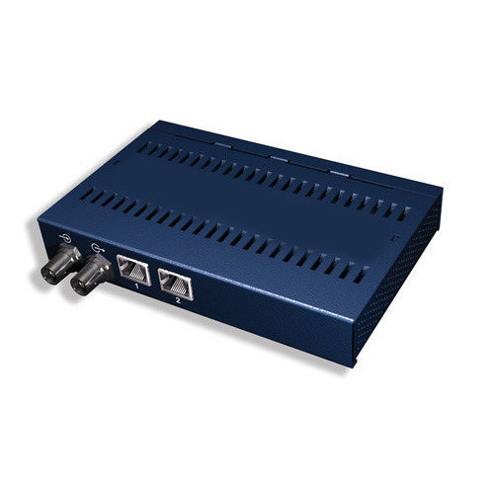
Repeater
A repeater operates at the physical layer. Its job is to regenerate the signal over the same network before the signal becomes too weak or corrupted so as to extend the length to which the signal can be transmitted over the same network. An important point to be noted about repeater is that they do not amplify the signal. When the signal becomes weak, the copy the signal bit by bit and regenerate it at the original strength. It is a w port device.

Slide 2
Hub
Types of Hub
A hub is basically a multiport repeater. A hub connects multiple wires coming from different branches, for example, the connector in star topology which connects different stations. Hubs cannot filter data, so data packets are sent to all connected devices. In other words, the collision domain of all hosts connects through Hub remains one. Also, they do not have the intelligence to find out the best path for data packets which leads to inefficiencies and wastage.
Active Hub
These are the hubs that have their own power supply and can clean, boost, and relay the signal along with the network. It sever both as a repeater as well as a wiring center. These are used to extend the maximum distance between nodes.

Slide 3
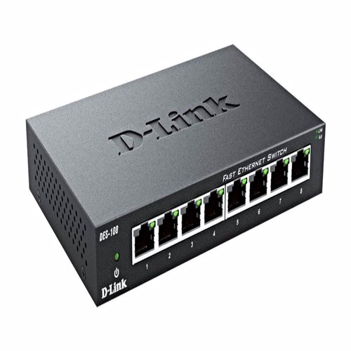
Passive Hub
These are the hubs that collect wiring from nodes and power supply from the active hub. These hubs relay signals onto the network without cleaning and boosting them and can’t be used to extend the distance between nodes.

Slide 4
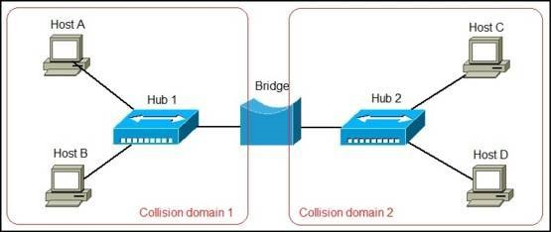
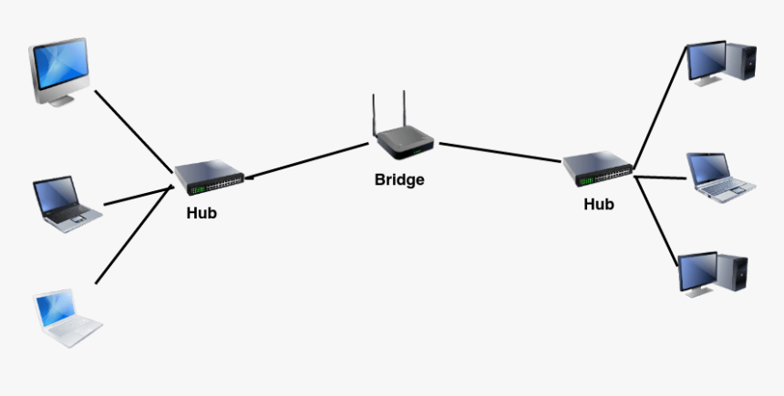
Bridge
A bridge operates at the data link layer. A bridge is a repeater, with add on the functionality of filtering content by reading the MAC addresses of source and destination. Fit is also used for interconnecting two LANs working on the same protocol. It has a single input and single output port, thus making it a 2 port device.

Slide 5
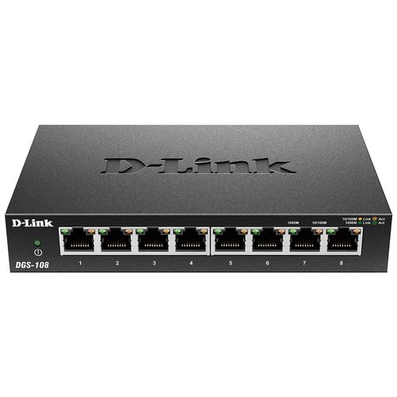
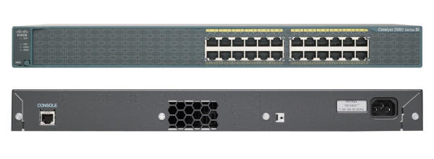
Switch
A switch is a multiport bridge with a buffer and a design that can boost its efficiency (a large number of ports imply less traffic) and performance. A switch is data link layer device. The switch can perform error checking before forwarding data, which makes it very efficient as it does not forward packets that have errors and forward good packets selectively to the correct port only. In other works, the switch divides the collision domain of hosts, but broadcast domain remain the same.

Slide 6
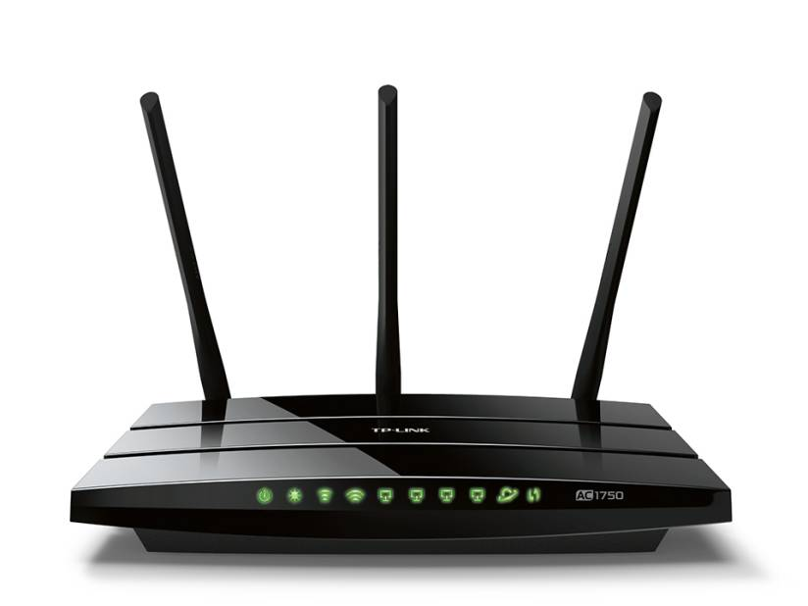
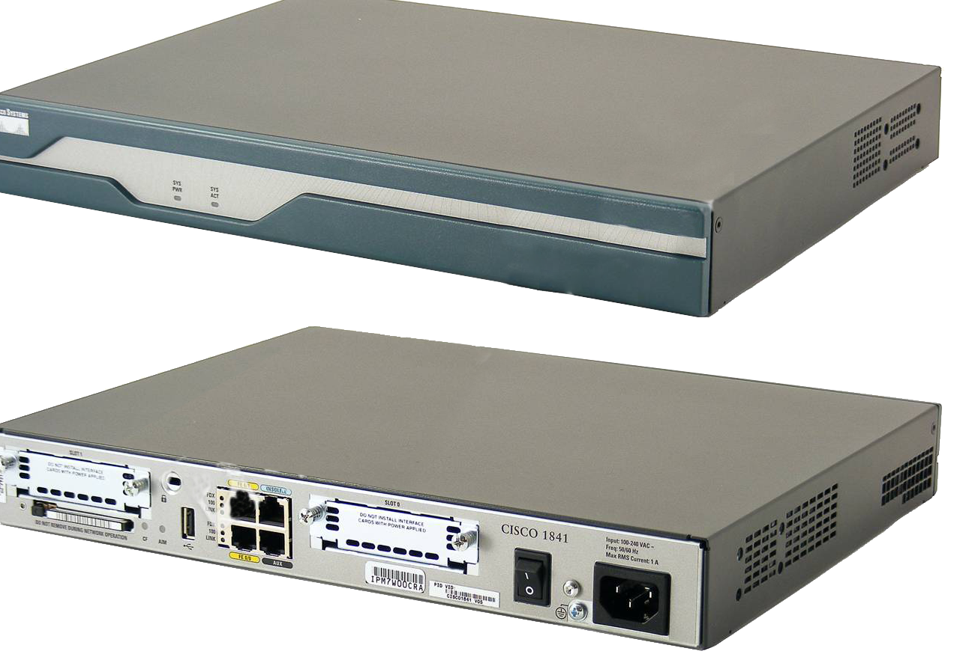
Router
Routers are electronic devices that join multiple computer networks together via either wired or wireless connections. A router is a networking device that forwards data packets between computer networks.
A router is a device like a switch that routes data packets based on their IP addresses. The router is mainly a Network Layer device. Router normally connect LANs and WANs together and have a dynamically updating routing table based on which they make decisions on routing the data packets. Router divide broadcast domains of hosts connected through it.

Slide 7
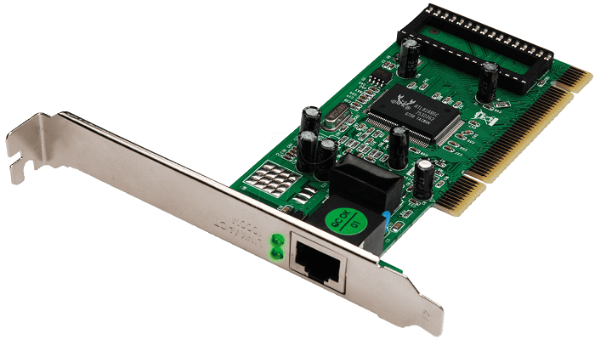
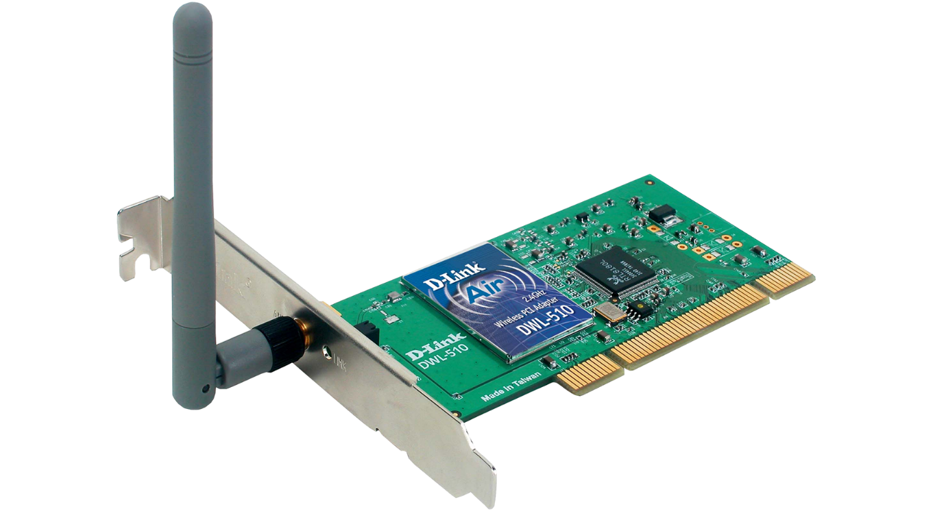
NIC (Network Interface Card)
A network interface controller NIC, also
known as a network interface card, network
adapter, Ethernet card, LAN adapter onboard
network card or physical network interface
and by similar terms is a computer hardware
component that connects a computer to a
computer network using an Ethernet cable
with an RJ-45 connector. NIC card is a layer 2 device which means that it works on both physical and data link layer of the network mode

Slide 8
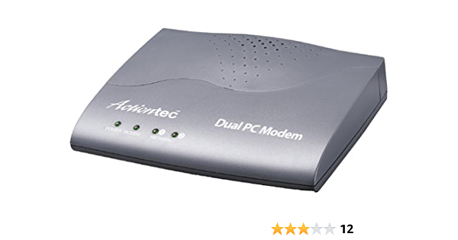
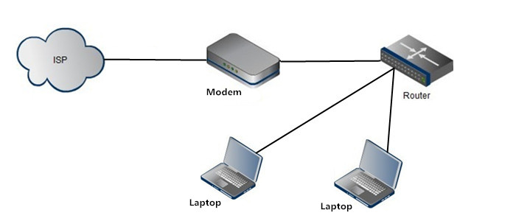
Modem
A modem (modulator–demodulator) is a network
hardware device that allows a computer to send and receive data over a telephone line or a cable or satellite connection. In the case of transmission over an analog telephone line, which was once the most popular way to access the internet, the modem converts data between analog and digital formats in real time for two-way network communication. In the case of the high-speed digital modems popular today, the signal is much simpler and doesn't require the analog-to-digital conversion.

Slide 9
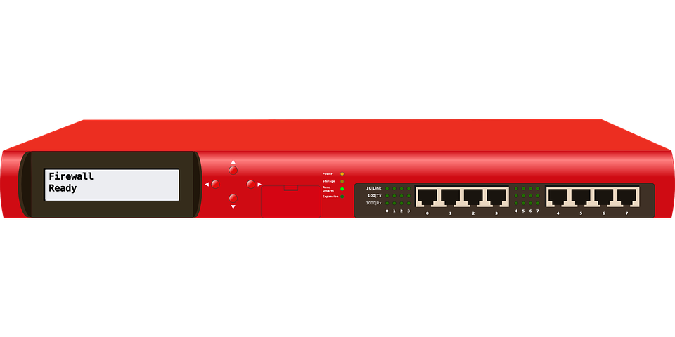
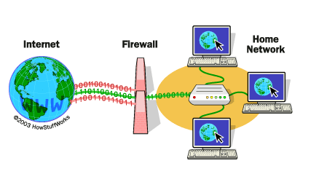
Firewall
A firewall is a network security device that monitors incoming and outgoing network traffic and decides whether to allow or block specific traffic based on a defined set of security rules. They establish a barrier between secured and controlled internal networks that can be trusted and untrusted outside networks, such as the Internet. A firewall can be hardware, software, or both. In computing, a firewall is a network security system that monitors and controls incoming and outgoing network traffic based on predetermined security rules.

Slide 10
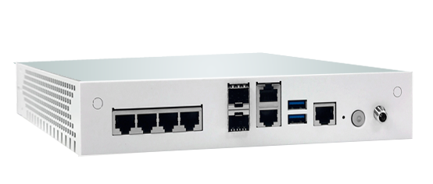
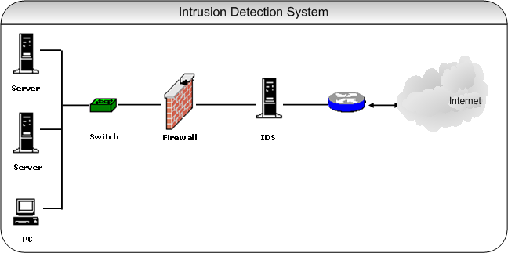
IDS/IPS/HIDS
Intrusion Detection System (IDS)
A device or application that analyzes whole packets, both header and payload, looking for known events. When a known event is detected a log message is generated detailing the event. similar to IPS but does not affect flows in any way - only logs or alerts on malicious traffic.

Slide 11
Intrusion Prevention System (IPS)
A device or application that analyzes whole packets, both header and payload, looking for known events. When a known event is detected the packet is rejected. inspects traffic flowing through a network and is capable of blocking or otherwise remediating flows that it determines are malicious. Usually uses a combination of traffic and file signatures and heuristic analysis of flows.
Host intrusion detection systems (HIDS)
Network intrusion detection systems (NIDS) are methods of security management for computers and networks. In HIDS, anti-threat applications such as firewalls, antivirus software and spyware-detection programs are installed on every network computer that has two-way access to the outside environment such as the Internet. In NIDS, anti-threat software is installed only at specific points such as servers that interface between the outside environment and the network segment to be protected.

